Slide 1
Operating systems:
Introduction, Program loading, History
Instructor: William Zheng
Email: william.zheng@digipen.edu
PHONE EXT: 1745
Notes:
1

Slide 2
Outline
Execution of a program
Boot Sequence
Roles of an OS
History of OS

Slide 3
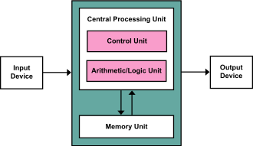
Von Neumann Model

Slide 4
Execution
Reg
PC
movq $10, %rax
movq $20, %rbx
andq %rax, %rbx
Inst. Reg
CPU
Memory

Slide 5
Fetch
Reg
PC
movq $10, %rax
movq $20, %rbx
andq %rax, %rbx
Instr. Reg
CPU
Memory

Slide 6
Decode
Reg
PC
movq $10, %rax
movq $20, %rbx
andq %rax, %rbx
Instr. Reg
movq $10, %rax
Instruction decoder
everything is in binary
need to decipher what the
instruction means.
CPU
Memory

Slide 7
Execute
Reg
PC
movq $10, %rax
movq $20, %rbx
andq %rax, %rbx
Instr. Reg
movq $10, %rax
Instruction decoder
Upon decoding the instruction,
pass over to the
ALU for execution.
ALU
CPU
Memory

Slide 8
Writeback
Reg
PC
movq $10, %rax
movq $20, %rbx
andq %rax, %rbx
Instr. Reg
movq $10, %rax
Instruction decoder
the result of the execution may
be written back to registers or
memory
ALU
CPU
Memory

Slide 9
Next instruction…Repeat the cycle
Reg
PC
movq $10, %rax
movq $20, %rbx
andq %rax, %rbx
Instr. Reg
Instruction decoder
the result of the execution may
be written back to registers or
memory
ALU
CPU
Memory

Slide 10
Program execution
So how does a program execute?
Naïve answer: load the program into memory and point the PC to the start of the program.
Outstanding questions:
Where to store the program in memory?
Which memory address is the 1st instruction of the program?
How much memory should I reserve for the running program?
How about stack and heap?

Slide 11
Executable and loading
Demo (Using cygwin)
Use objdump program to examine an executable
gcc hello-world.c –o hello-world.exe
objdump –D hello-world.exe (to disassemble program)
objdump -s -j .data hello-world.exe (to examine the data section)
objdump –x hello-world.exe (to see all section headers)

Slide 12
Loading a Program
Need a program called a loader
Able to read the executable format
Copy the text and data segments into the correct memory addresses.
Allocate space for Stack and heap for the new running program
Set the Program Counter value to the address of the starting instruction of the loaded program.
The newly loaded program runs

Slide 13
Layout of an executable
Main header
How many sections,
address of start instruction etc
Program Header
How much memory needed,
these sections need to be in these addresses etc
Text Segment
Code
Data Segment
Data used in your program i.e., global variables
String Table
Really an extension of data segment. Strings such
as “hello world”.

Slide 14
ELF Object File Format
Elf header
Word size, byte ordering, file type (.o, exec, .so), machine type, etc.
Segment header table
Page size, virtual addresses memory segments (sections), segment sizes.
.text section
Code
.rodata section
Read only data: jump tables, ...
.data section
Initialized global variables
.bss section
Uninitialized global variables
“Block Started by Symbol”
“Better Save Space”
Has section header but occupies no space
ELF header
Segment header table
(required for executables)
.text section
.rodata section
.data section
.bss section
.symtab section
.rel.txt section
.rel.data section
.debug section
Section header table

Slide 15
ELF Object File Format
.symtab section
Symbol table
Procedure and static variable names
Section names and locations
.rel.text section
Relocation info for .text section
Addresses of instructions that will need to be modified in the executable
Instructions for modifying.
.rel.data section
Relocation info for .data section
Addresses of pointer data that will need to be modified in the merged executable
.debug section
Info for symbolic debugging (gcc -g)
Section header table
Offsets and sizes of each section
ELF header
Segment header table
(required for executables)
.text section
.rodata section
.data section
.bss section
.symtab section
.rel.txt section
.rel.data section
.debug section
Section header table

Slide 16
Symbol Resolution
Referencing
a global…
…that’s defined here
int sum(int *a, int n);
int array[2] = {1, 2};
int main()
{
int val = sum(array, 2);
return val;
}
int sum(int *a, int n)
{
int i, s = 0;
for (i = 0; i < n; i++) {
s += a[i];
}
return s;
}
main.c
sum.c
Defining
a global
Referencing
a global…
Linker knows
nothing of i or s
Linker knows
nothing of val
…that’s defined here

Slide 17
Relocation
Relocatable Object Files
Executable Object File
System code
.text
0
Headers
System data
.data
System code
main()
.text
main.o
swap()
main()
.text
.data
More system code
int array[2]={1,2}
System data
.data
sum.o
sum()
int array[2]={1,2}
.text
.symtab
.debug

Slide 18
Portable Executable File Format
MS-DOS 2.0 Compatible EXE Header
OEM Identifier
OEM Information
Offset to PE Header
MS-DOS 2.0 Stub Program and Relocation Table
PE Header (aligned on 8-byte boundary)
Section Headers
Image Pages:
import info
export info
base relocations
resource info
Microsoft COFF Header Section Headers
Raw Data:
code
data
debug info
relocations
https://msdn.microsoft.com/library/windows/desktop/ms680547(v=vs.85).aspx
c:>dumpbin /headers hello-world.exe

Slide 19
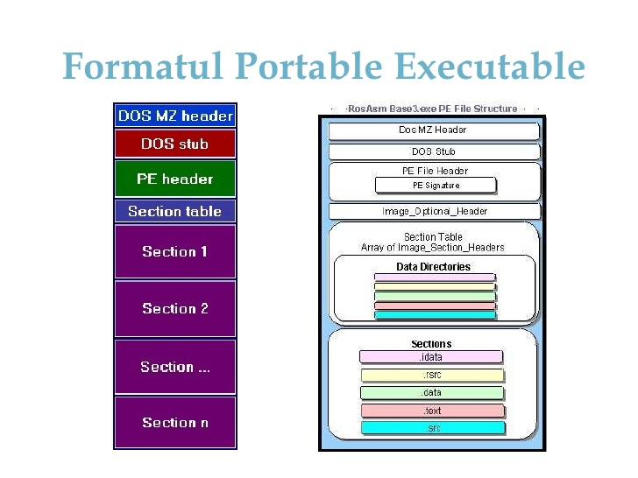
PE Example - illustration

Slide 20
Loader
Chicken and egg problem
Who loads the loader?
Need to talk about the boot sequence

Slide 21
Boot-up process - I
Power-On (HW up & running)
Run BIOS
Memory-mapped to FFFFFFFF0h
Performs POST test
Initialize peripherals etc
Search through the secondary storages i.e., hard disks for bootable drive
CPU
Memory
Decode
Execute
Writeback
Cache
BIOS

Slide 22
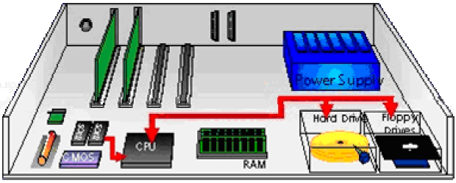
Boot-up process - II
Power-On (HW up & running)
Run BIOS
BIOS load and run
MBR (Master Boot Record)
Boot Record
1st Sector Boot Record
Small (512 Bytes)
MBR
CPU
Memory
Decode
Execute
Writeback
Cache
MBR
BIOS

Slide 23
Boot-up process - III
bootloaders
Power-On (hardware up & running)
Run BIOS
BIOS load and run MBR
MBR may load boot loaders (chain-loading)
MBR
CPU
Memory
Decode
Execute
Writeback
Cache
MBR
BIOS

Slide 24
Boot-up process - IV
bootloaders
Power-On (hardware up & running)
Run BIOS
BIOS load and run MBR
MBR may load boot loaders (chain-loading)
MBR
CPU
Memory
Decode
Execute
Writeback
Cache
Bootloaders
BIOS

Slide 25
Boot-up process - V
bootloaders
Power-On (hardware up & running)
Run BIOS
BIOS load and run MBR
MBR may load boot loaders (chain-loading)
Load and run OS
MBR
OS
CPU
Memory
Decode
Execute
Writeback
Cache
OS
Instruction Fetch
Data read/write
BIOS

Slide 26
Why Need BIOS?
Initialize and Test HW Components
ensure that the components are attached, functional and accessible to the Operating System (OS)
Load bootloader or OS
BIOS loads the OS directly or loads the bootloader and then passes control to the bootloader
Provide an abstraction layer for I/O devices
BIOS facilitates the interaction btw OS and application by providing an abstraction layer for I/O devices.

Slide 27
What does an OS do?
Interface/Abstraction
API for programmers
Remove need for low-level details
Portability
Resource Management
Virtualization
Security
Notes:
OS first appeared as a subroutine “library” shared by all users. Library: pull card decks from wall.

Slide 28
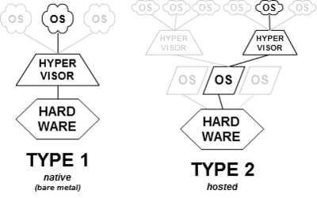
Virtualization
Hypervisor/Virtual Machine Monitor (VMM)
Xen
Hyper V
VMware ESX
VMware
Workstation/
Player VirtualBox
Parallels Desktop for Mac

Slide 29
Before there were computers
“Computers” are more like super-sized calculators
Notes:
OS first appeared as a subroutine “library” shared by all users. Library: pull card decks from wall.

Slide 30
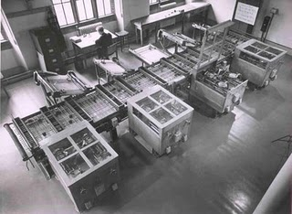
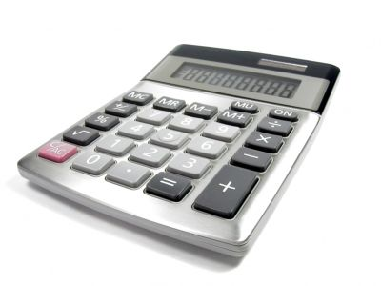
<1950s: Initial computing machines
Cambridge Differential Analyzer
Notes:
The very first so-called computers – were actually more like calculators. The main thing is they are designed to do one application only. In short, these machines are not what we would call programmable. You can key in different inputs to get the machines to output different results, but the “task performed” if you like, remains unchanged. “Reprogramming” if you like, is tedious, involves changing how the machine is set-up physically etc.

Slide 31
Before there were computers
“Computers” are more like super-sized calculators
Non-programmable
Only 1 function
To change the function, a massive re-engineering project
Notes:
OS first appeared as a subroutine “library” shared by all users. Library: pull card decks from wall.

Slide 32
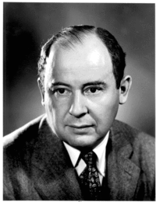
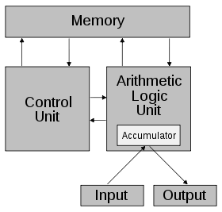
Something’s brewing in 1940s…
Von Neumann wrote a paper titled
“First Draft of a report on the EDVAC”
Computers consists of 5 Parts:
CA
CC
M
I
O
Connected by address bus, data bus and control bus.
All these proposed in 1945! And the model still fits till now.

Slide 33
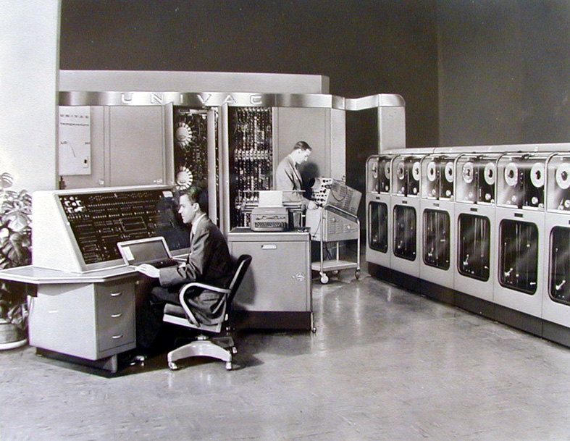
Mainframes
UNIVAC I (1951), 1000 cu. feet, 2000 additions per second

Slide 34
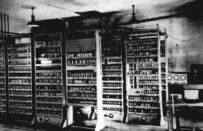

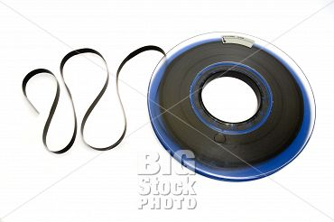
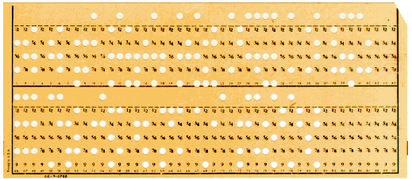
Lifetime of a program – in early 1950s
Write the program(in assembly by
hand!)
2. Write the program in the form of punch-cards/tapes
3. Load the program manually
from tapes/punched cards
4. If error occurs, (how is an error detected?), programmer examine memory and registers directly.
5. Output was in form of punched cards or tapes

Slide 35
Problems
Assembly Programming
Error prone
Labor intensive
Reinventing the wheel
I/O Peripherals
Computer expensive, cheap labor
Need to keep the computer running as busy as possible.
Partly solved by high-level programming languages.
FORTRAN, COBOL
Introduction of library routines

Slide 36
Running a program after FORTRAN…
Loading the FORTRAN compiler tape ( with FORTRAN program as input)
Running the compiler
Unloading the compiler tape (assembly code is printed as output)
Loading the assembler tape (with assembly code as input)
Running the assembler
Unloading the assembler tape (object program is printed as output)
Loading the object program tape
Running the object program
Big Problem:
While all the loading and unloading is being done, the CPU is idle!

Slide 37

Initial Solution
Get a computer operator (better and faster at loading/unloading tapes)
Batch the same jobs together.
Lab
Student A:
Help me run my
FORTRAN program
Student B:
Help me run my
COBOL program
Student C:
Help me run my
FORTRAN program
Lab Operator:
Why don’t I load the FORTRAN compiler only once and compile the FORTRAN jobs before I deal with the COBOL job?

Slide 38
Not good enough
When a job stops…
Who knows? Maybe the lab operator is sleeping or outside the lab.
In between jobs
Loading and unloading is still slow.

Slide 39
Resident Monitor
Memory
Loader
Device drivers
Control card
interpreter
Idea
Computers fast. Humans slow.
Automatic job loader in memory.
Resident
Monitor
User
Programs
Loaded
here
Notes:
It is difficult for us to imagine how difficult it is to run programs on the earliest machines.
Load FORTRAN tape
Run compiler
Unload tape
Load assembler tape
Unload assembler
Load object program
Run object program

Slide 40
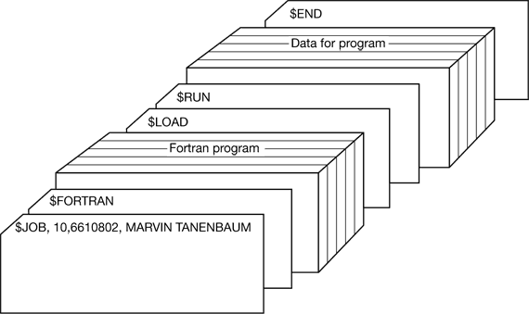
An example batch job cards

Slide 41
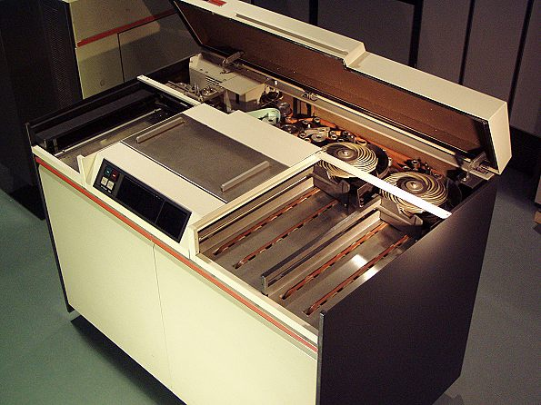
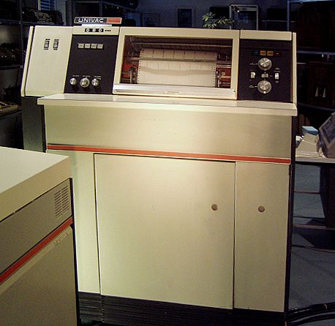
Hardware I/O libraries
Punched cards
Card reader 10 cards/s
635kg! printer
Notes:
To be sure, the earliest computers are not interactive systems as we would understand it i.e. no keyboards or mouse connected to them. Instead what we have connected to the computers are huge I/O devices. Such as this card reader and the printer. This printer is 635kg in weight! So, when you want to load something into the computer, such as data or code, you have to get these punched cards (I don’t know how to read one) and punch it in using one of the keypunch machines (that is something like a typewriter) and then you move the cards over to the card reader for loading.
What happens then is that very soon, people realize that communication with these devices can be quite complicated. You have buffers, flags, registers, control bits etc for each particular device. So even reading a character from the card or tape in some cases, can be very tedious and complicated. We will explain the details of I/O interaction with the computer later in this lecture. But the point is that you don’t want to write code that deals with the devices every time. So what happens is that you developed a HW I/O routine library for interacting with the I/O.

Slide 42
So how are we doing in dealing with this problem?
Computer expensive, cheap labor
Need to keep the computer running as busy as possible.
What kind of bottlenecks do we have so far?
Loading a
program
Running a
program
Getting the
Output

Slide 43
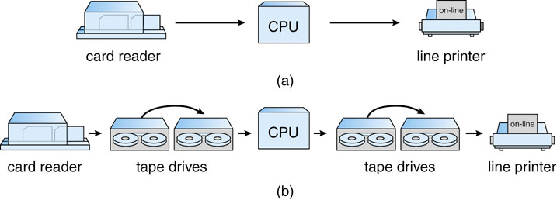
Overlapped I/O
Card Reader /line printer slower than Tape Drives
Read
card
Running a
program
Read
card
Running a
program
Read
card
Print
Print
…
Read
card
Read
card
Read
card
Read
card
…
Read
tape
Running a
program
Write
tape
Read
tape
Running a
program
Write
tape
Read
tape
Running a
program
Print
Print
Printing

Slide 44
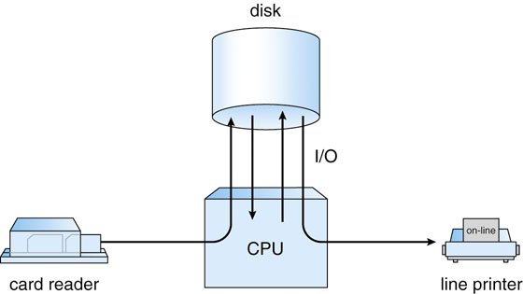
Tapes versus disks
Sequential versus random access
Fast to read “card” and write “card”
SPOOL (Simultaneous Peripheral Operation On-Line)
Leads to multiprogramming

Slide 45
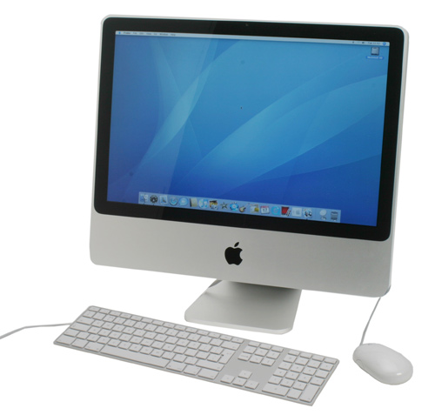
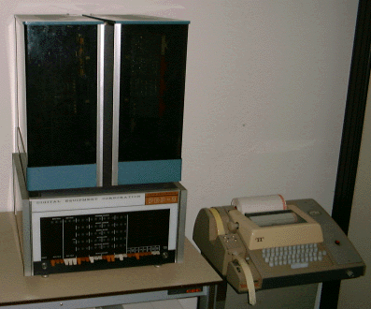
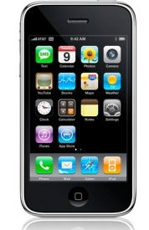
Minicomputers Desktops, Handhelds
Desktops: ? cu ft,
6 billion additions per second
Minicomputers: 8 cu. Feet,
330000 additions per second
Handhelds: in ur hand!,
600 million additions per second

Slide 46
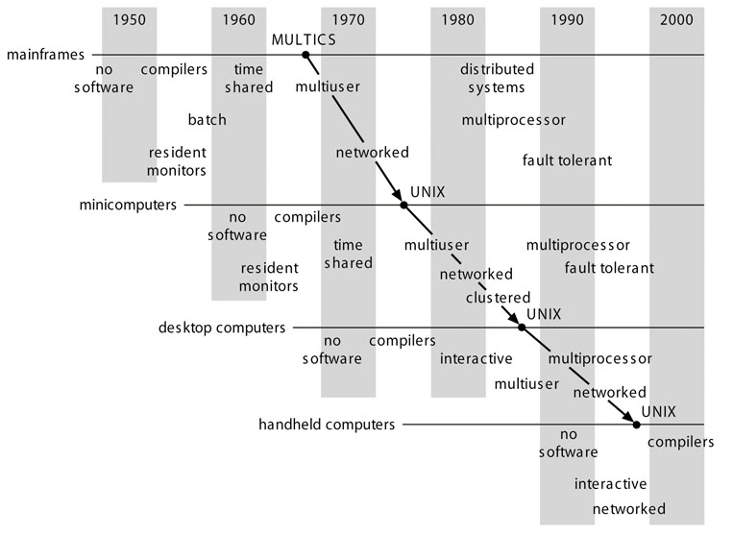
History of Computers
Notes:
This graph shows us the timeline or history of operating systems. In particular, we observe that there are 4 different kinds of computers mentioned here. Mainframes, minicomputers, desktop computers and handhelds. The easiest way to read this graph, I guess, is to trace the development of a particular kind of computer. Then you realize that the pattern is being repeated. For example, if you trace the mainframes, it began with no software before 1950, then compilers and resident monitors come in, then time-sharing comes in (we will explain these terms later, time sharing means that different programs can be run on the same system at the same time) and later, the mainframes developed to become multi-user, networked etc. And we see sort of the same development in desktop computers too. So this is a case of history repeating itself for every new kind of computer invented. For our purposes, we shall be focusing mainly on this part (click). Although this is quite an early period in computer history, we need to know that most of the basic concepts are invented during this decade.

Slide 47
5 Phases
Phase 1 (1948—1970)
Phase 2 (1970 – 1985)
Phase 3 (1981- )
Phase 4 (1988 -): Distributed Systems
Phase 5 (1995 -): Mobile Systems

Slide 48
Phase 1 (1948—1970)
Hardware Expensive, Humans Cheap
When computers cost millions of $’s, optimize for more efficient use of the hardware!
Lack of interaction between user and computer
User at console: one user at a time
Batch monitor: load program, run, print
Optimize to better use hardware
When user thinking at console, computer idle⇒BAD!
Feed computer batches and make users wait
No protection: what if batch program has bug?
Notes:
OS first appeared as a subroutine “library” shared by all users. Library: pull card decks from wall.

Slide 49
Phase 2 (1970 – 1985)
Hardware Cheaper, Humans Expensive
Computers available for tens of thousands of dollars instead of millions
OS Technology maturing/stabilizing
Interactive timesharing:
Use cheap terminals (~$1000) to let multiple users interact with the system at the same time
Sacrifice CPU time to get better response time
Users do debugging, editing, and email online
Problem: Thrashing
Performance very non-linear response with load
Thrashing caused by many factors including
Swapping, queueing
Response
time
Users
Notes:
Computers are friendly things: 1 terminal, feed me. Add another terminal, feed me. Can you keep doing this? NO!
Eventually fall off a cliff (add one more user, computer slows down by a factor of 1000)

Slide 50
Phase 3 (1981- )
Hardware Very Cheap, Humans Very Expensive
Computer costs $1K, Programmer costs $100K/year
If you can make someone 1% more efficient by giving them a computer, it’s worth it!
Use computers to make people more efficient
Personal computing:
Computers cheap, so give everyone a PC
Limited Hardware Resources Initially:
OS becomes a subroutine library
One application at a time (MSDOS, CP/M, …)
Eventually PCs become powerful:
OS regains all the complexity of a “big” OS
multiprogramming, memory protection, etc (NT,OS/2)
Question: As hardware gets cheaper does need for OS go away?
Notes:
No, Feature creep. PC made OS a subroutine all over again. But then realized even single users need memory protection, multiprogramming, etc. Same is true of PDAs and phones

Slide 51
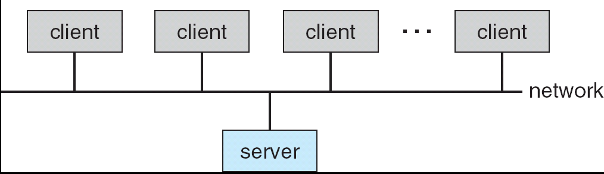
Phase 4 (1988 -): Distributed Systems
Networking (Local Area Networking)
Different machines share resources
Printers, File Servers, Web Servers
Client – Server Model
Services
Computing
File Storage
Notes:
Why do we need distributed systems? Resource sharing (printers, Internet connections,…) and info sharing (files, email, IM, …)

Slide 52
Phase 4 (1988 -): Internet
Developed by the research community
Based on open standard: Internet Protocol
Internet Engineering Task Force (IETF)
Technical basis for many other types of networks
Intranet: enterprise IP network
Services Provided by the Internet
Shared access to computing resources: telnet (1970’s)
Shared access to data/files: FTP, NFS, AFS (1980’s)
Communication medium over which people interact
email (1980’s), on-line chat rooms, instant messaging (1990’s)
audio, video (1990’s, early 00’s)
Medium for information dissemination
USENET (1980’s)
WWW (1990’s)
Audio, video (late 90’s, early 00’s) – replacing radio, TV?
File sharing (late 90’s, early 00’s)

Slide 53
Phase 5 (1995 -): Mobile Systems
Ubiquitous Mobile Devices
Laptops, PDAs, phones
Small, portable, and inexpensive
Recently twice as many smart phones as PDAs
Many computers/person!
Limited capabilities (memory, CPU, power, etc…)
Wireless/Wide Area Networking
Leveraging the infrastructure
Huge distributed pool of resources extend devices
Traditional computers split into pieces. Wireless keyboards/mice, CPU distributed, storage remote
Peer-to-peer systems
Many devices with equal responsibilities work together
Components of “Operating System” spread across globe

